Slide 1
Looking into Gait for Perceiving Emotions via Bilateral Posture and Movement Graph Convolutional Networks
The Tenth Group
IYingjie Zhai*, Guoli Jia*, Yu-Kun Lai, Jing Zhang, Jufeng Yang, and Dacheng Tao, Fellow, IEEE
2024-12-9

Slide 2
1. Authors & Abstract
Outline
2. Introduction
3. Related work
4. Method
5. Experiment
6. Conclusion

Slide 3
1. Authors & Abstract
Outline
汇报人：詹耿羽
2. Introduction
3. Related work
4. Method
5. Experiment
6. Conclusion

Slide 4
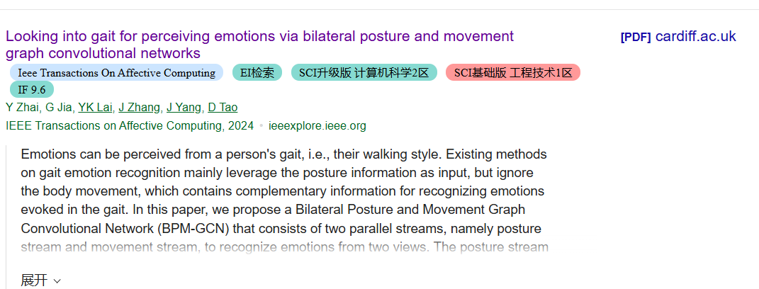
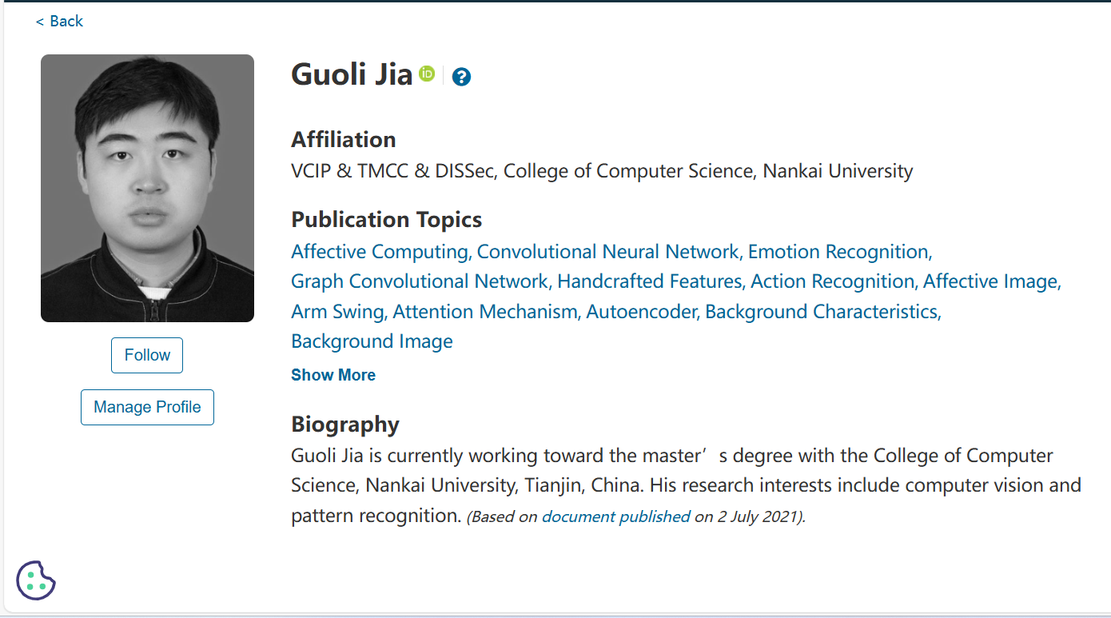
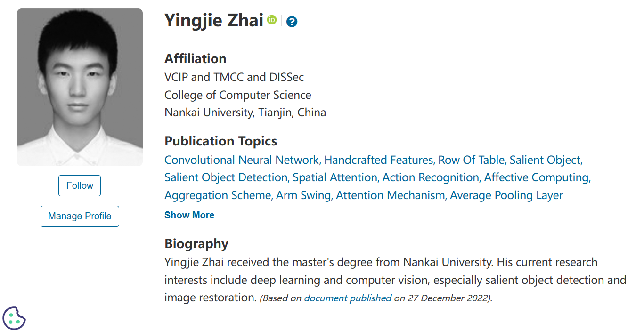
Author

Slide 5
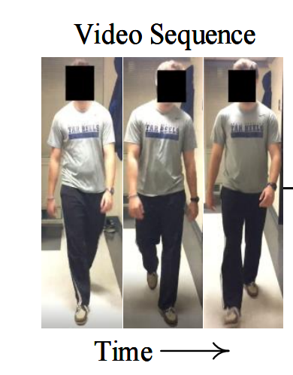
Abstract

Slide 6
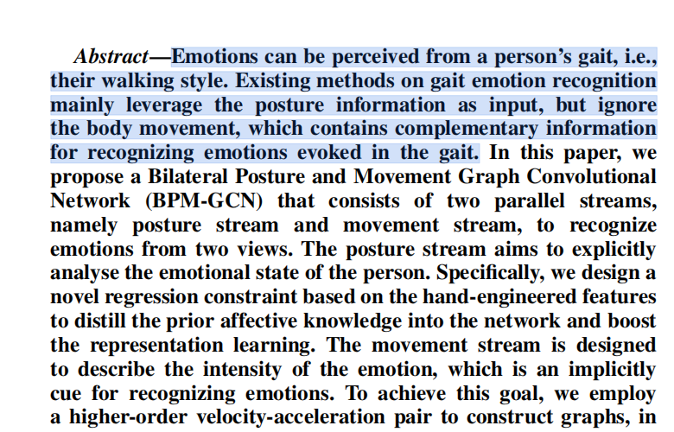
Correlation between gait and mood（步态与情绪的关联）
Gait as an outward expression of emotion
Gait is a natural reflection of an individual's emotional state,
and different emotional states lead to changes in gait characteristics.
Existing methods on gait emotion recognition mainly leverage the posture information as input, but ignore the body movement, which contains complementary information for recognizing emotions evoked in the gait.

Slide 7
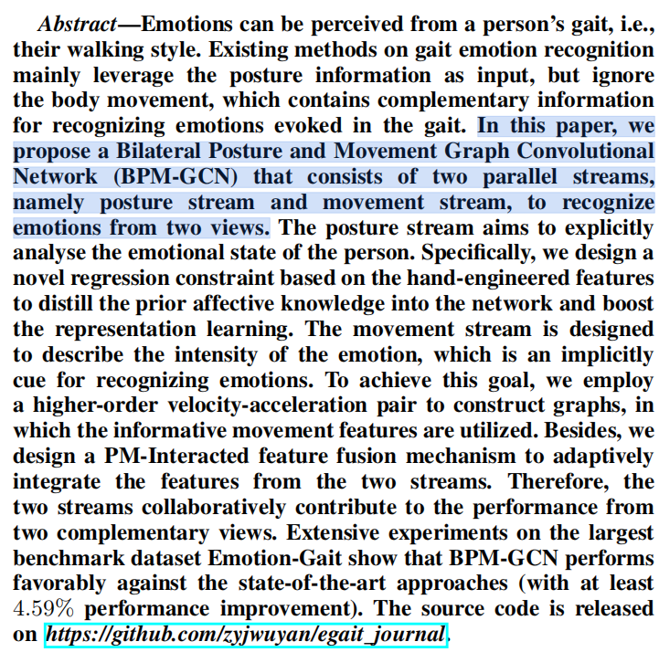
What have they done?
In this paper, we propose a Bilateral Posture and Movement Graph Convolutional Network (BPM-GCN) that consists of two parallel streams, namely posture stream and movement stream, to recognize emotions from two views.
在本文中，我们提出了一种双侧姿态和运动图卷积网络（BPM-GCN），它由两个平行流（即姿态流和运动流）组成，可从两个视角识别情绪。

Slide 8
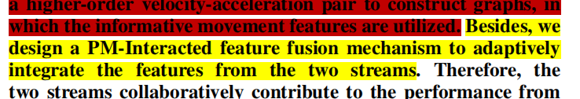
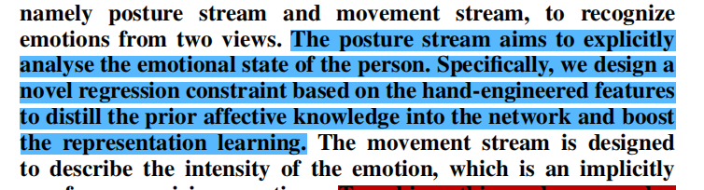
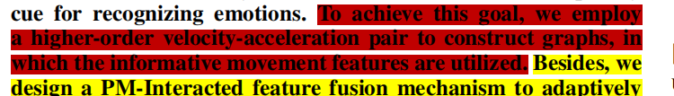
BPM-GCN Architecture
Two-stream parallel processing mechanism
Emotional knowledge distillation of postural flow
Emotional intensity description of movement flow
姿势流和运动流，分别处理姿势和运动信息。
设计了一种新的基于手工设计特征的回归约束
速度- 加速度对的图

Slide 9
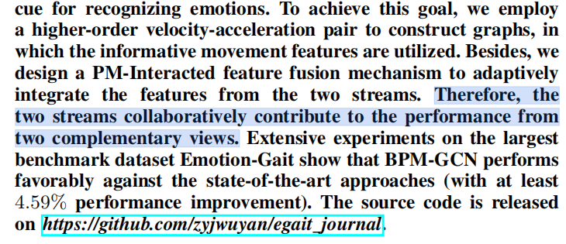
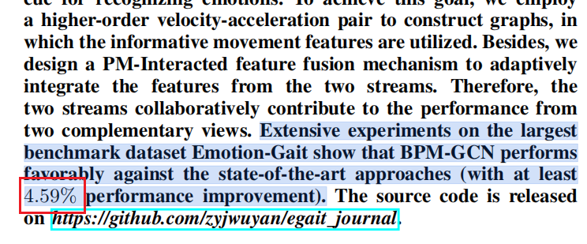
Performance improvement (experimental results)
Emotion-Gait数据集
在Emotion- Gait数据集上进行实验，验证BPM- GCN的有效性。
性能提升
BPM- GCN在准确率上至少提高了4.59%，显著超越了最先进的方法。

Slide 10
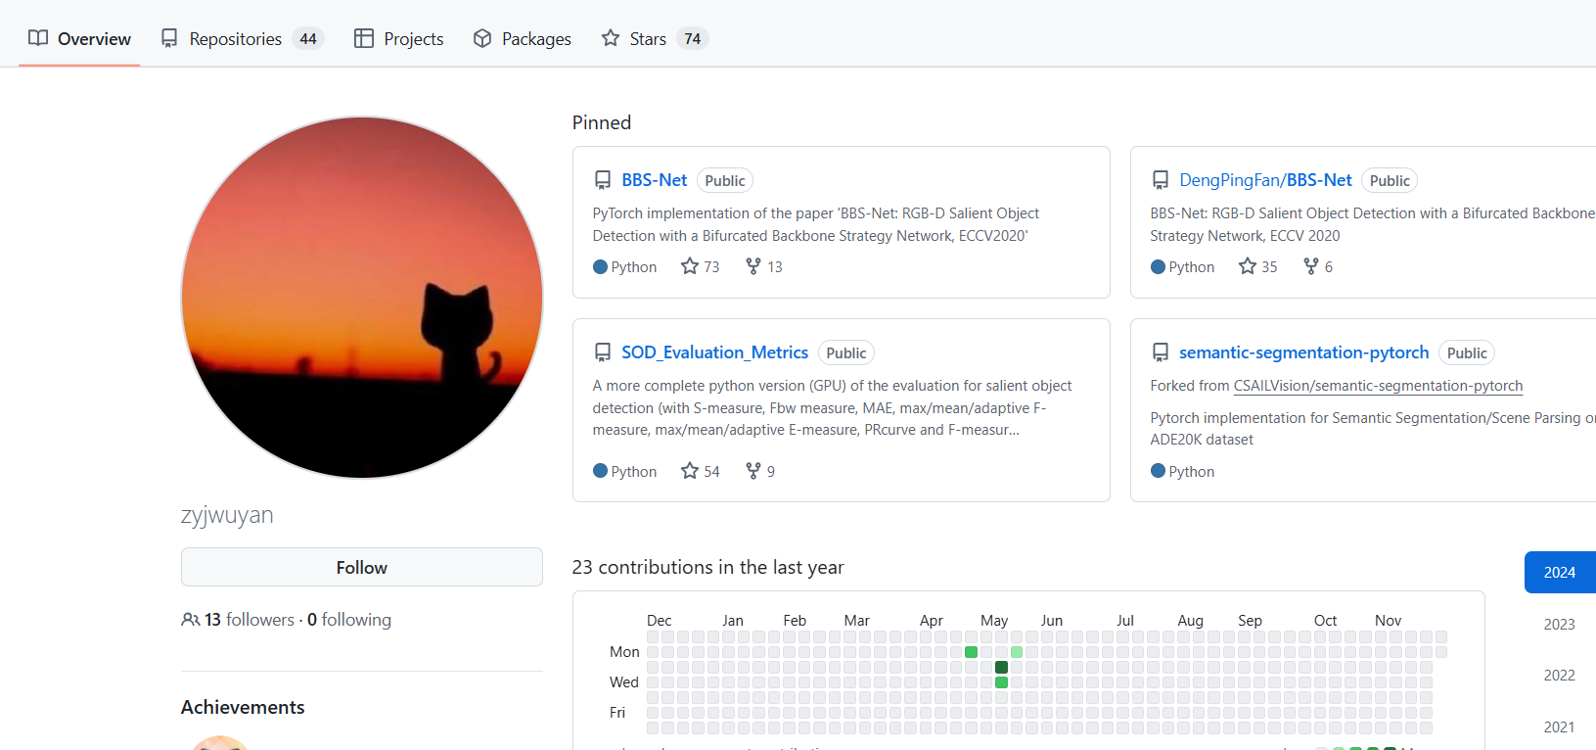
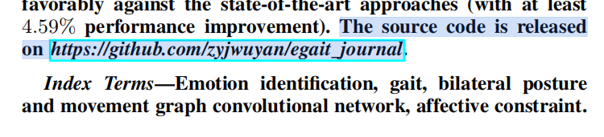
source code
Source code is provided to support academic research and further development, link to the code: https://github.com/zyjwuyan/egait_journal.
01
02

Slide 11
1. Title & Abstract
Outline
2. Introduction 汇报人：李文俊
3. Related work
4. Method
5. Experiment
6. Conclusion

Slide 12
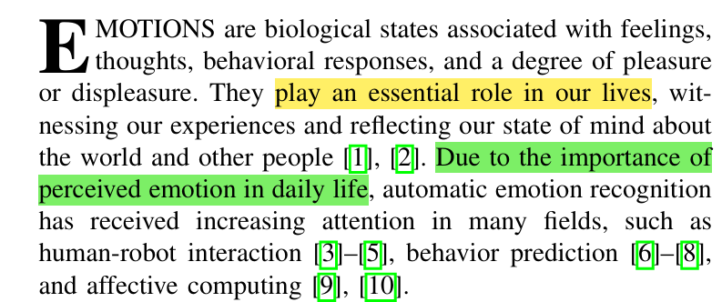
Hook
Emotions
Automatic emotion recognition
Due to the importance of… ,
… has received increasing attention.
Affective 情感的——同义词Emotional Affective更常用于学术研究

Slide 13
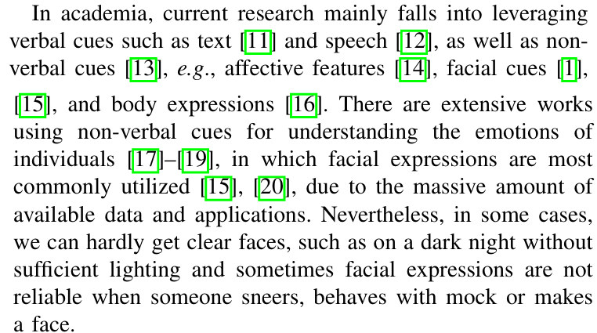





Hook
verbal cues
介绍目前研究重点
non-verbal cues
大量可用数据和应用程序
某些情况下存在问题
verbal 言语的
sneer 嘲笑 mock 模仿 make a face 做鬼脸

Slide 14
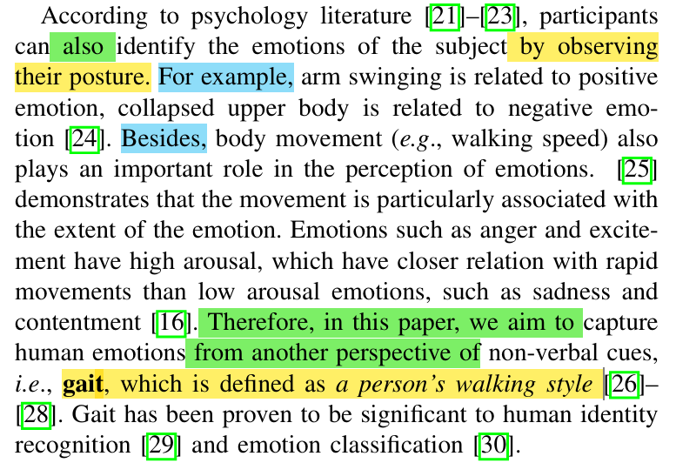
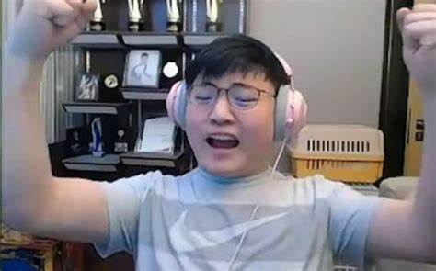



Background information
Automatic emotion recognition
Posture
Body movement
Gait
Collapsed adj.收缩的
arousal n.唤醒
High arousal（高唤起）指的是一种生理和心理状态，表示个体的身体和心理激活程度较高

Slide 15
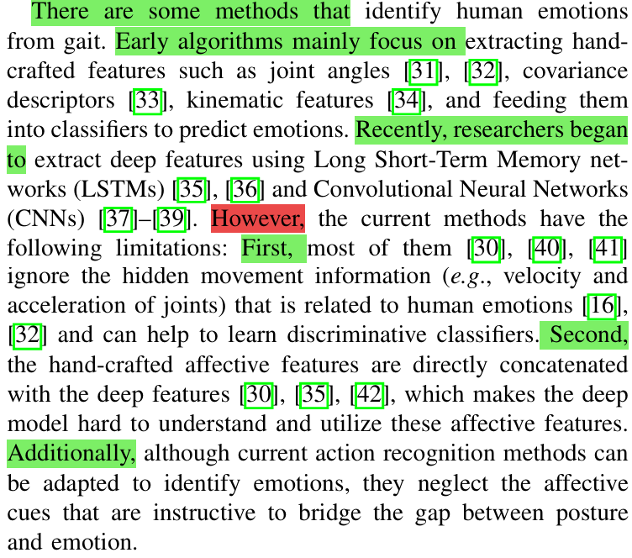








Thesis statement
介绍领域的方法
Early
Hand-crafted features
Recently
Deep features
Gap
Explain why it needs to be filled
extract v. 提取
Hand-crafted 手工制作的
Concatenate v. 连接

Slide 16
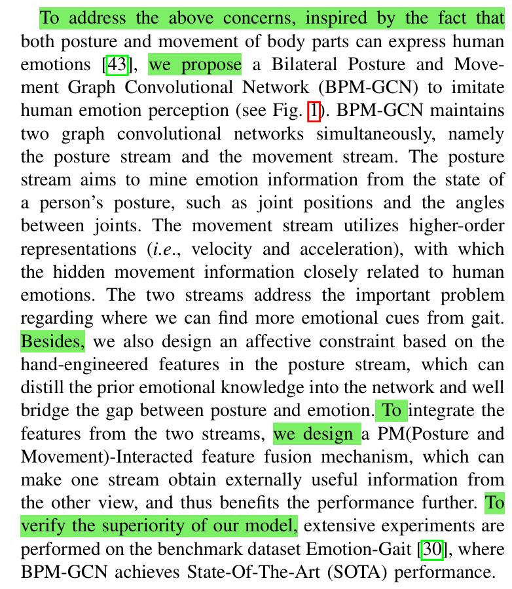
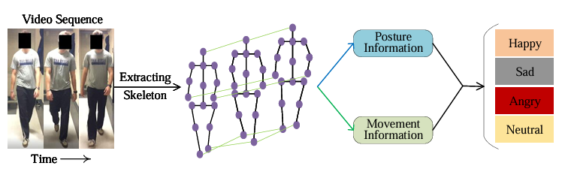







介绍自己的方法
BPM-GCN
Affective constraint
contribution
PM-Interacted feature fusion mechanism
Summarize how this study attempts to fill that gap
State-Of-The-Art (SOTA) performance
novel 新颖的
fourfold 四部分的
mine … from … 从…挖掘
superiority 优越性
imitate 模仿 simultaneously同时地 constraint约束 distill提取
骨架

Slide 17
1. Title & Abstract
Outline
2. Introduction
3. Related work 汇报人：张卫濠
4. Method
5. Experiment
6. Conclusion

Slide 18
Related work
In this section, we review prior works that are related to this paper. Specifically, we group them into two categories: 1.Gait Emotion Recognition 2.Skeleton-based Action Recognition
1.步态情感识别
2.基于骨架的动作识别

Slide 19
Gait Emotion Recognition
Related work
find that people with joy tend to open forearms while they will tighten their bodies to be self-protective when they are frightened.
some researchers argue that body posture also plays an important role in human feeling expression For example, experiments in show that participants can recognize basic emotions with high accuracy from point-light arm movements of two actors who are instructed to perform drinking and knocking movements with ten different affects.

Slide 20
Gait Emotion Recognition
Related work
walk while experiencing five emotions (joy, contentment, anger, sadness, and neutral), and the experiments indicate that the fastest walking velocity is for joy and anger, and the slowest is for sadness. Besides, when participants are in sadness, they flex the neck and thoracic, but they extend the trunk or depress the shoulder when they are joyful.

Slide 21
Gait Emotion Recognition
Related work
walk while experiencing five emotions (joy, contentment, anger, sadness, and neutral), and the experiments indicate that the fastest walking velocity is for joy and anger, and the slowest is for sadness. Besides, when participants are in sadness, they flex the neck and thoracic, but they extend the trunk or depress the shoulder when they are joyful.

Slide 22
Gait Emotion Recognition
Related work
传统方法：大多数之前的方法都是基于手工制作的特征（hand-crafted features）
其他研究方法：使用盲源分离技术、基于关节角度的分类、使用离散傅里叶变换和统计方法，以及比较不同监督模型的性能
Most previous approaches are based on hand-crafted features .Omlor and Giese [58] develop a new non-linear source separation technique. Venture et classify five emotions based on joint angles .Li et perform the discrete Fourier transform and statistical methods on gait collected from Microsoft Kinect to identify emotions.

Slide 23
Gait Emotion Recognition
Related work
新数据集与模型：
提出了一个新的数据集Emotion-Gait，包含2,177个人类步态和外部合成步态，标注了四种情感类别。
针对此数据集，Narayanan等人提出了一个多视角骨架模型来识别行人情感，用于社会感知的机器人导航。
STEP模型：基于时空图卷积网络的情感感知模型
researchers started to develop deep models. present a new dataset, called Emotion-Gait, that contains 2,177 human gait and external synthetic gait with annotations of four emotional categories. They also propose a Spatial Temporal graph convolution-based network for Emotion Perceiving (STEP). Narayanan et propose a multiview skeleton model to identify emotions for socially aware robot navigation among pedestrians

Slide 24
Skeleton-based Action Recognition
Related work
3D关节坐标进行动作或情绪识别，
层次递归神经网络（RNNs）将关节分为多个部分，分别输入到对应的子网中，并以层次化的方式融合从子网中提取的特征。 Convolutional Neural Networks (CNNs): 除了RNNs，CNNs在动作识别中也显示出巨大的潜力。
We aim to identify emotions from gait represented by 3D joint coordinates., Recurrent Neural Networks (RNNs) are widely used in skeleton-based action recognition. , which divides joints into multiple parts, feeds them to corresponding subnets, and further fuses the features extracted from subnets in a hierarchical way. CNNs have also shown great potential for action recognition.

Slide 25
Skeleton-based Action Recognition
Related work
Graph Convolutional Networks (GCNs): 近年来，GCNs在基于骨架的动作识别中占据了主导地位。
空间-时间图卷积网络（ST-GCN）可以自动从关节坐标中提取空间和时间特征。
动作-结构图卷积网络（AS-GCN）旨在学习特定于动作的潜在依赖关系。
Recently, skeleton-based action recognition algorithms have been dominated by Graph Convolutional Networks (GCNs). a Spatial-Temporal Graph Convolutional Network (ST-GCN), propose an Actional-Structural Graph Convolutional Network (AS-GCN)

Slide 26
1. Title & Abstract
Outline
2. Introduction
3. Related work
4. Method 汇报人：杨子烽
5. Experiment
6. Conclusion

Slide 27
Outline
III. METHODOLOGY
A. Definition and Overview（定义和概述）
In this section, we first make a definition and present a brief overview of the proposed method in § III-A.
Then, we elaborate the proposed bilateral posture and movement GCN(BPM-GCN) in § III-B, including the details of the movement
stream and posture stream.
Besides, we introduce the PM Interacted feature fusion mechanism, which can effectively fuse the features from both streams, in § III-C
B. Bilateral Posture and Movement GCN
（双侧姿势和运动 GCN）
C. BPM-GCN with PM-Interacted Feature Fusion
（ BPM-GCN与PM-相互作用的特征融合）

Slide 28
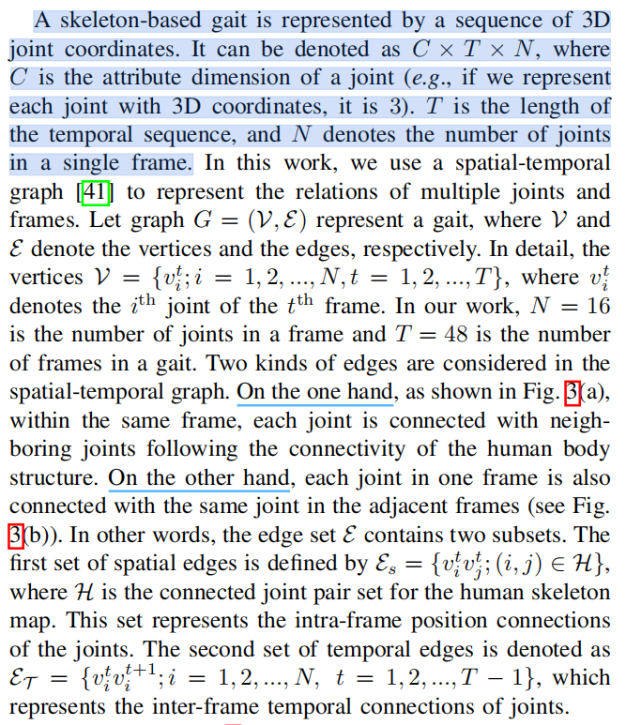
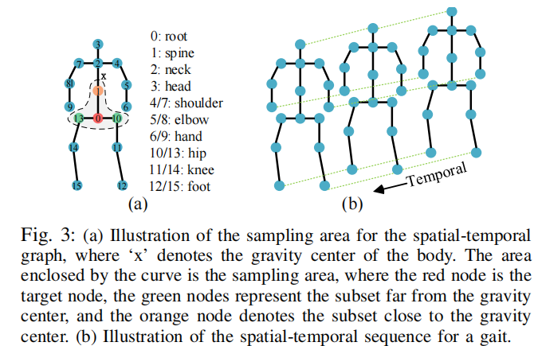
Outline
Definition and Overview
定义阐述：
一个基于骨骼的步态是由一系列的三维关节坐标来表示的。它可以表示为C×T×N，其中C是一个关节的属性维数（例如，如果我们用三维坐标表示每个关节，它是3）。T为时间序列的长度，N表示单个帧中的关节数。

Slide 29
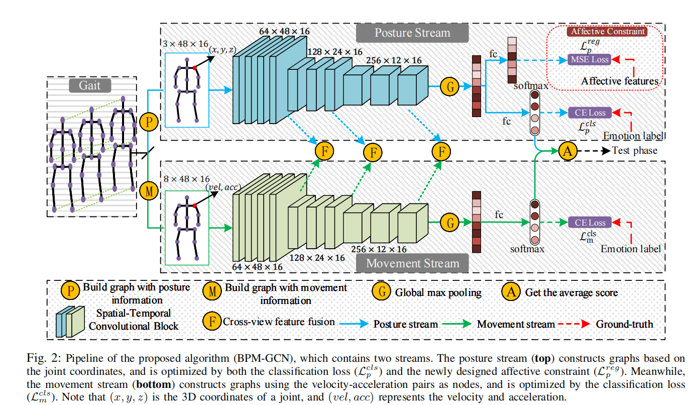
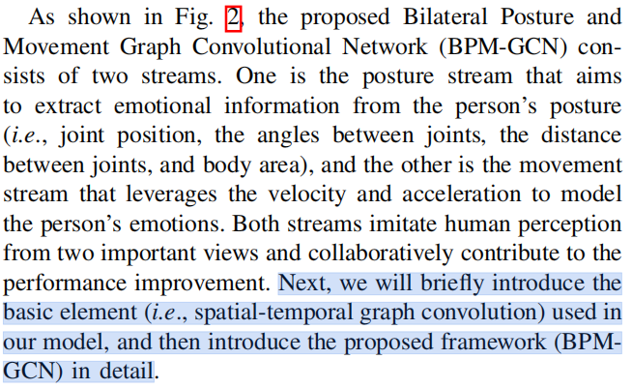
Outline
接下来，我们将简要介绍在我们的模型中使用的基本元素（即时空图卷积），然后详细介绍所提出的框架（BPMGCN）

Slide 30
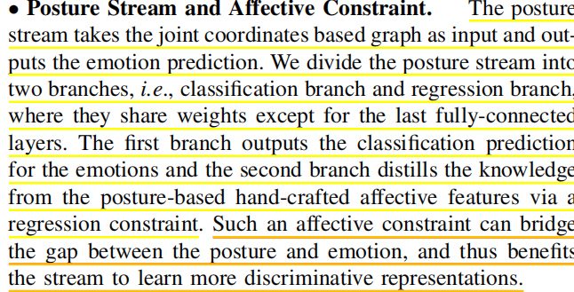
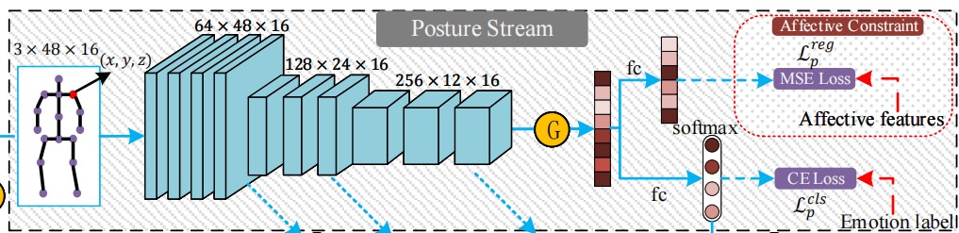
Bilateral Posture and Movement GCN
• Posture Stream and Affective Constraint.
姿势流和情感约束
idea
effect

Slide 31
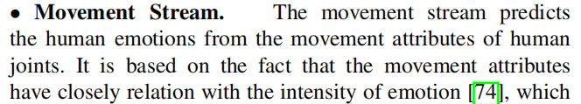
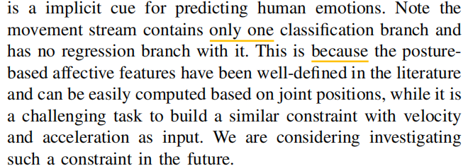
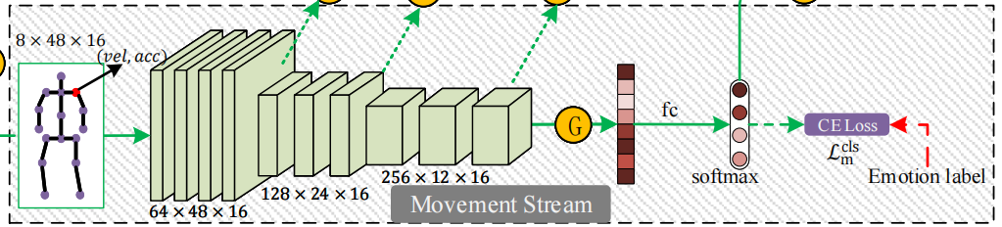
Outline
• Movement Stream.

Slide 32
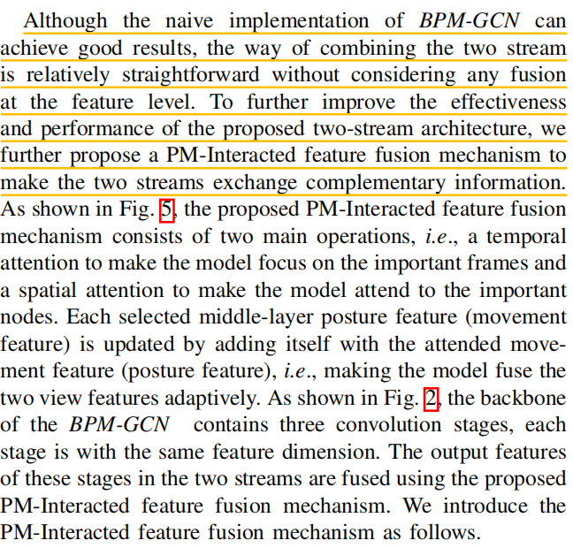
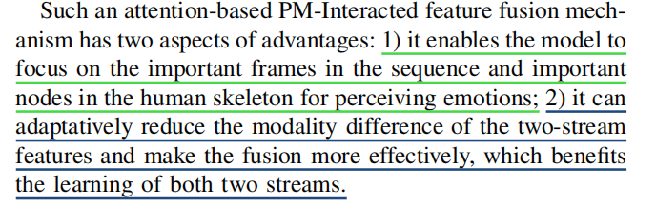
Outline
BPM-GCN with PM-Interacted Feature Fusion
reason：
BPM-GCN与PM-相互作用的特征融合
fuction：

Slide 33
1. Title & Abstract
Outline
2. Introduction
3. Related work
4. Method
5. Experiment 汇报人: 廖金威 罗毅
6. Conclusion

Slide 34
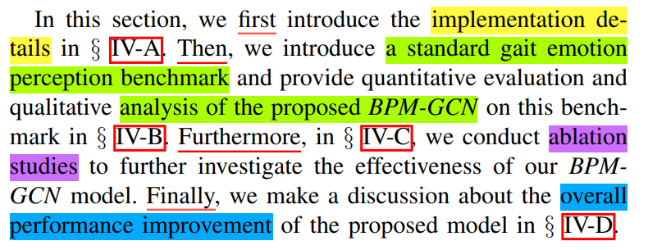
Experiment
5
总起：
IV-A: Experiment Setup
implementation details
IV-B: Comparison with SOTAs
analysis of the proposed BPM-GCN
IV-C: Ablation Studies
ablation studies
IV-D: Discussion about the Performance Improvement
overall performance improvement
Connective words:
First…
Then…
Furthermore…
Finally…

Slide 35
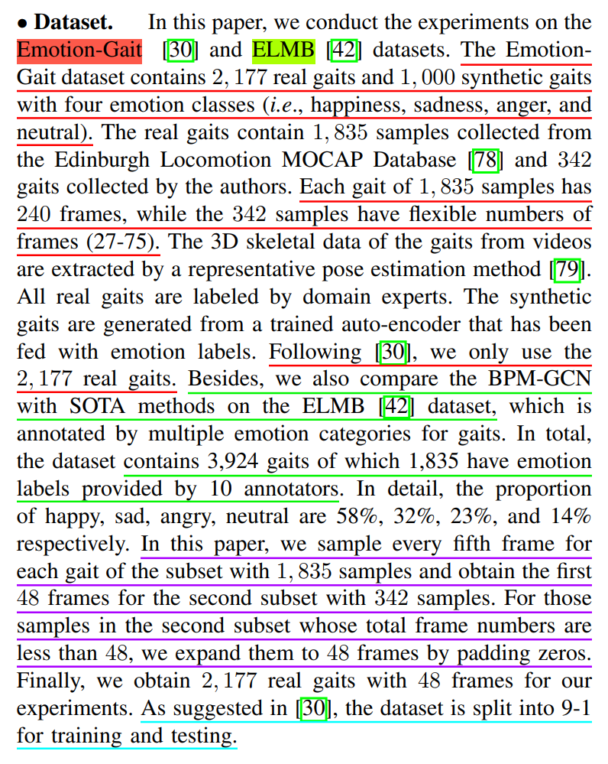
A. Experiment Setup
5
数据集介绍：
Emotion-Gait数据集：包含2,177个真实步态和1,000个人造步态，涵盖四种情绪类别：快乐、悲伤、愤怒和中性。
ELMB数据集：
用于与SOTA（State-of-the-Art，即最先进的）方法进行比较。包含3,924个步态，其中1,835个有情绪标签，由10个标注者提供。
情绪类别的比例为：快乐58%，悲伤32%，愤怒23%，中性14%。
数据预处理：
对于1,835个样本的子集，作者每隔五帧采样一次。
对于342个样本的子集，作者取每个步态的前48帧，如果这些样本的总帧数少于48帧，作者通过用零填充的方式将它们扩展到48帧。
最终数据集：
经过上述处理后，作者最终得到了2,177个真实步态，每个步态包含48帧，用于他们的实验。
数据集分割：
根据文献[30]的建议，数据集被分成9:1的比例用于训练和测试，即90%用于训练，
10%用于测试。

Slide 36
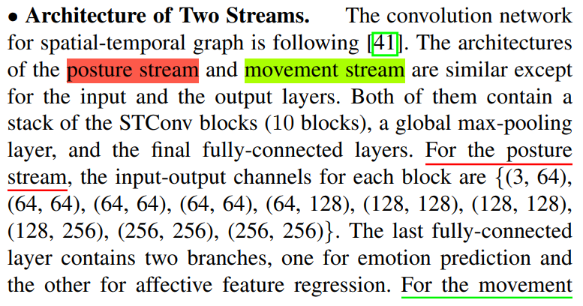
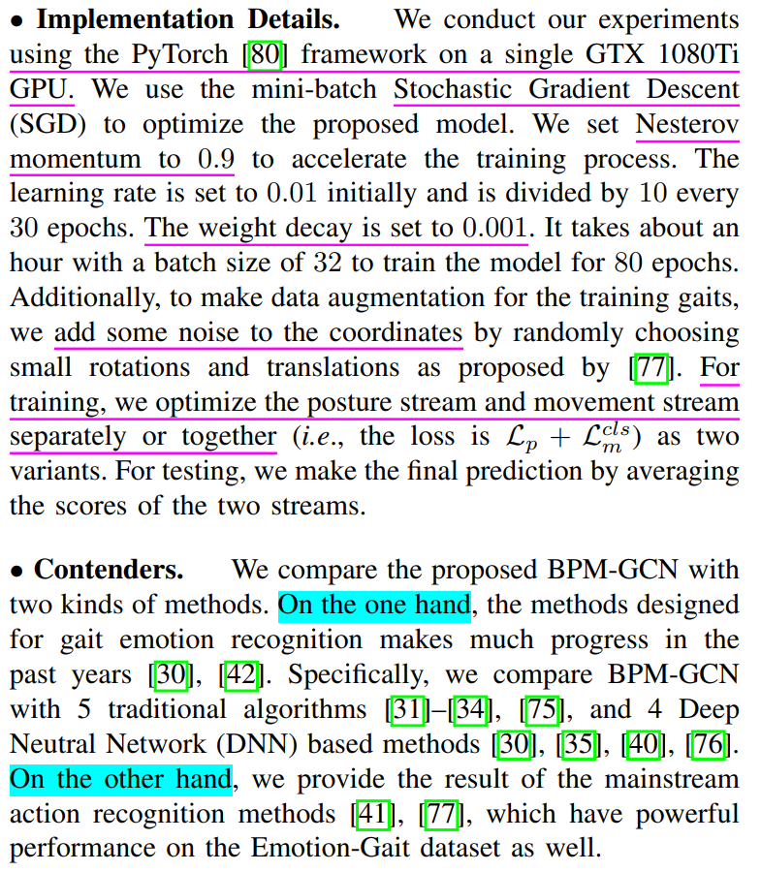
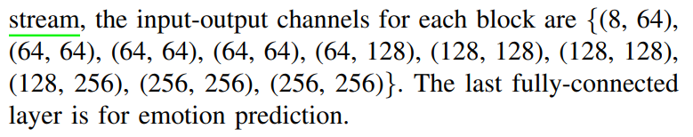
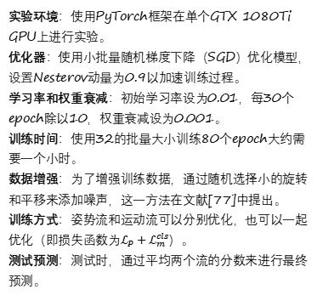
A. Experiment Setup
5
实验环境：使用PyTorch框架在单个GTX 1080Ti GPU上进行实验。
优化器：使用小批量随机梯度下降（SGD）优化模型，设置Nesterov动量为0.9以加速训练过程。
学习率和权重衰减：初始学习率设为0.01，每30个epoch除以10，权重衰减设为0.001。
训练时间：使用32的批量大小训练80个epoch大约需要一个小时。
数据增强：为了增强训练数据，通过随机选择小的旋转和平移来添加噪声，这一方法在文献[77]中提出。
训练方式：姿势流和运动流可以分别优化，也可以一起优化（即损失函数为$ℒ_{P}+ℒ_{m}^{cls}$）。
测试预测：测试时，通过平均两个流的分数来进行最终预测。
空间-时间图卷积网络：模型遵循文献[41]中的方法，使用空间-时间图卷积（STConv）块构建网络。
承上启下段
通过对比，展示BPM-GCN在步态情绪识别方法和
动作识别方法上的优势
姿势流和运动流：输入输出通道和全连接层存在差异

Slide 37
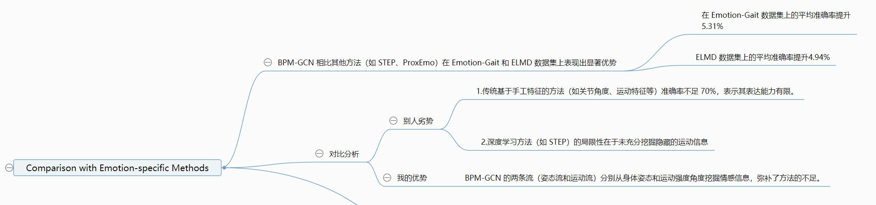
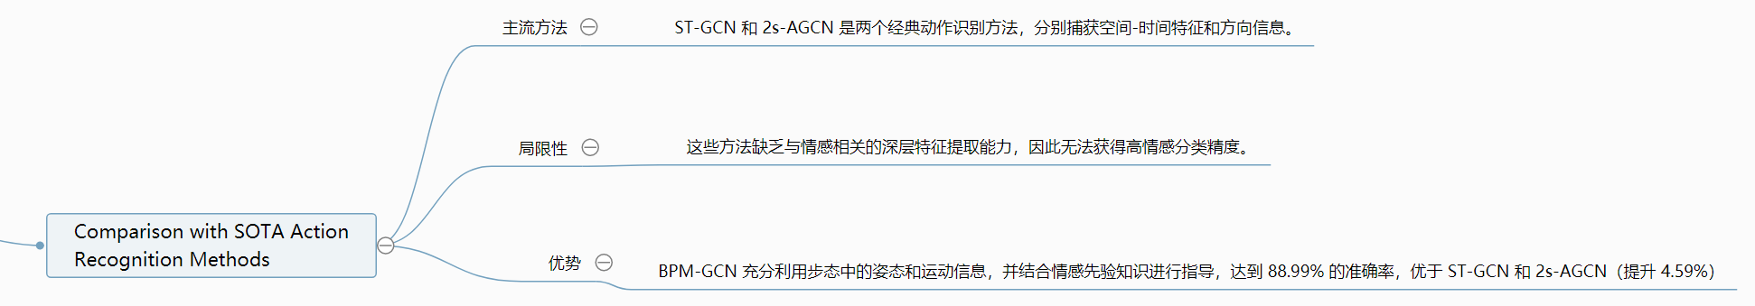
B. Comparison with SOTAs
5
• Comparison with Emotion-specific Methods.
• Comparison with SOTA Action Recognition Methods.

Slide 38
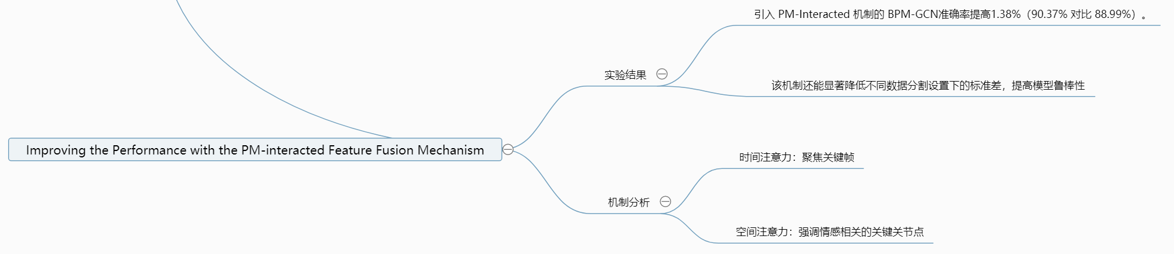
B. Comparison with SOTAs
5
• Improving the Performance with the PM-interacted Feature Fusion Mechanism.
• Difffculty of recognizing different emotions
实验结果显示，快乐情绪的识别准确率普遍超过95%，而中性情绪的识别准确率通常低于45%。
原因可能是：
1. 数据类别不平衡（中性样本仅 198 个）
2. 中性情感的固有难度较高（与正面或负面情感差异不明显）
为了消除类别样本数量不平衡的影响，进行了一个实验，使得每个类别的样本数量相同。
结果显示，悲伤情绪最容易识别，愤怒情绪的识别准确率最低。
• Effect of synthetic samples
通过将Emotion-Gait数据集中的1000个合成样本纳入训练集，观察到悲伤情绪的识别准确率有所提高，而愤
怒和中性情绪的识别准确率提高不一致。
使用合成样本后，除了BPM-GCN，其他方法的快乐情绪识别准确率有所下降，整体准确率也有所下降。

Slide 39
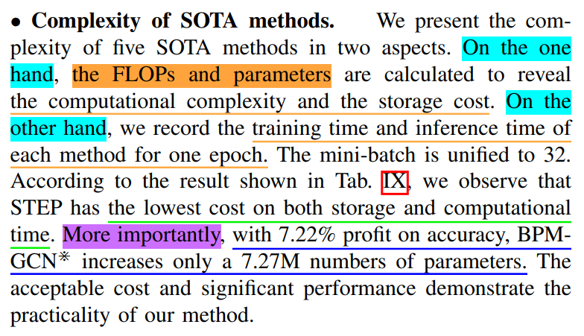
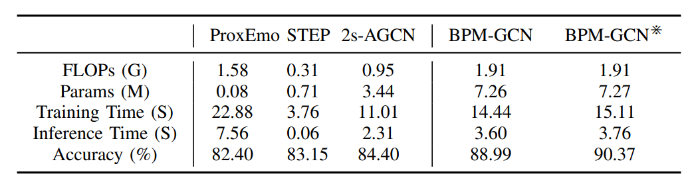
B. Comparison with SOTAs
5
BPM-GCN⋇: 这是BPM-GCN的改进版本，它引入了PM-Interacted Feature Fusion（PM-交互特征融合）机制。这种机制允许姿势流和运动流之间共享特征
计算成本：
对比了 5 种 SOTA 方法的 FLOPs（计算量）、参数数量、训练时间和推理时间。
BPM-GCN⋇ 的参数增加量适中（增加 7.27M 参数），但性能提升显著（7.22% 的准确率收益）。
实际意义：
BPM-GCN⋇ 兼具较低的存储与计算成本和出色的性能，具有实际应用价值

Slide 40
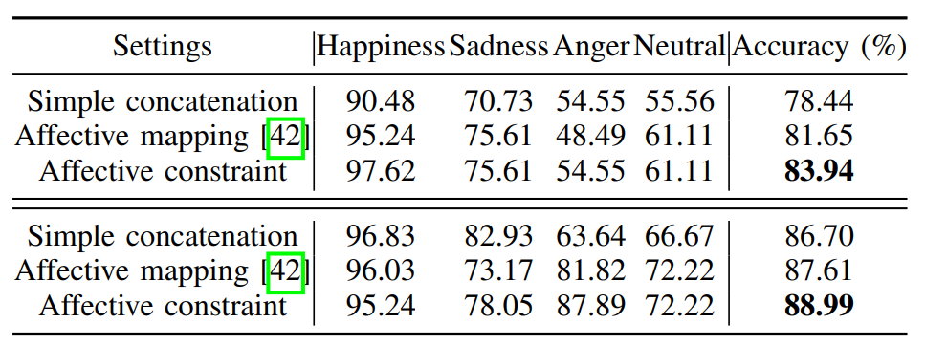
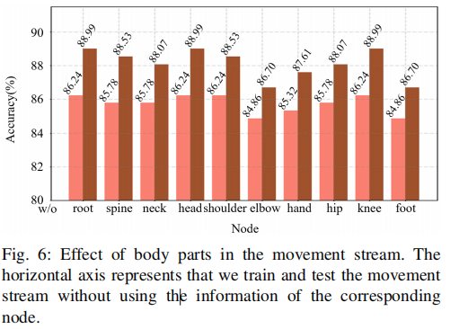
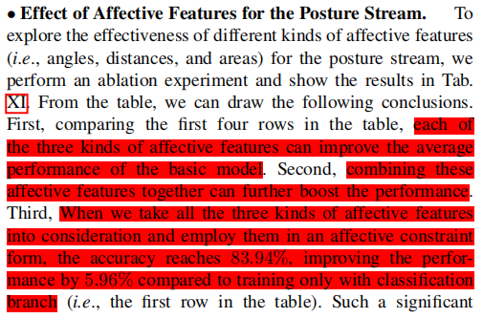
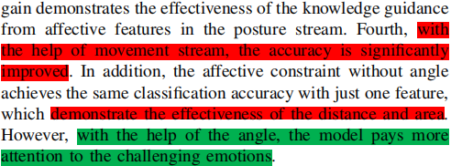
Experiments

Slide 41
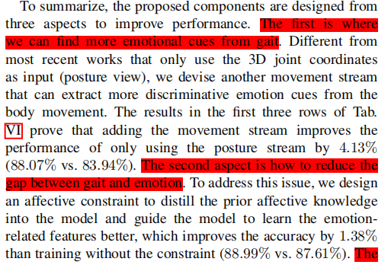
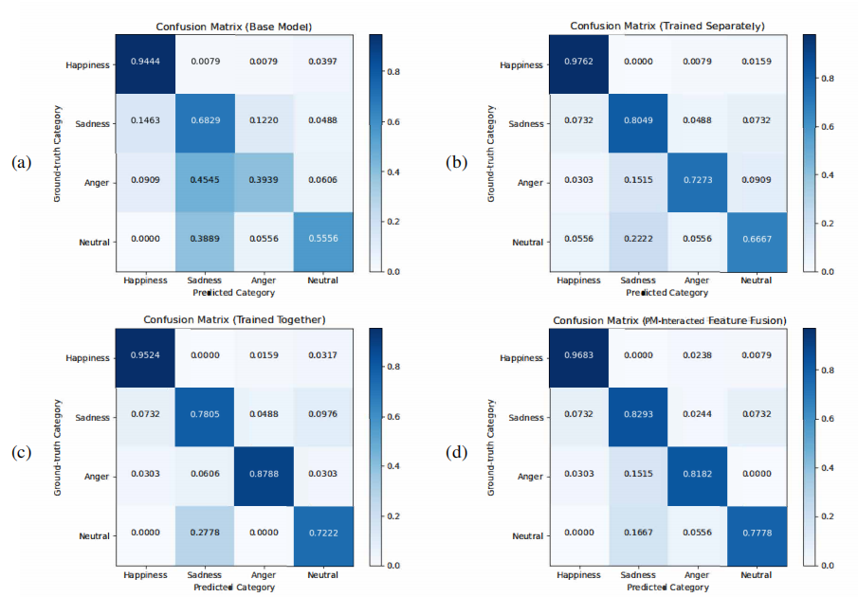
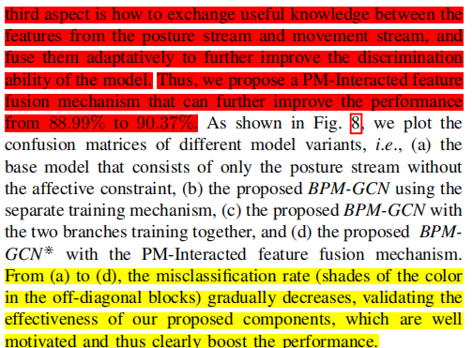
Performance Impoevement
Experiments:Ablation studies

Slide 42
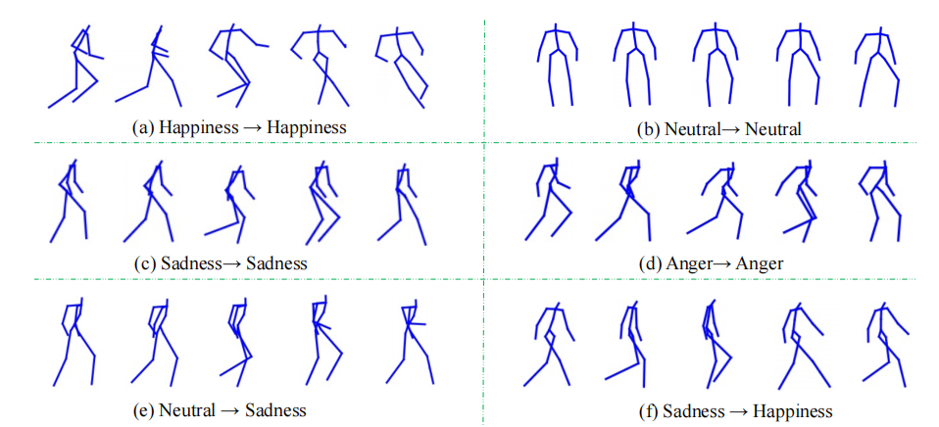

To
Experiments

Slide 43
1. Title & Abstract
Outline
2. Introduction
3. Related work
4. Method
5. Experiment
6. Conclusion 汇报人：王紫坤

Slide 44

Conclusion
Motivate（WHY）
Methods（HOW TO DO）
Experiment（SHOW EFFECT）
Future（MORE AFFECT）

Slide 45
Thanks for your attention
Q & A

